Slide 1
HONEST Review’s
Your Ultimate Destination for film Insights

Slide 2
Team Member’s
Name | Roll Number
Bussu Lakshmi Prakash Reddy | 201021467023
Y. Samyuktha | 201021467034
Datrika Raj Kumar | 201021467037

Slide 3
ABSTRACT
The Honest Movie Reviews website is your go-to spot for genuine opinions on the latest films. It's a place where movie buffs can share their thoughts openly and see what others are saying too.
Imagine a platform where you can read real reviews from real people about the movies they've watched recently. That's what this website offers. Whether it's a big-budget blockbuster or a hidden indie gem, you'll find diverse viewpoints here.
What sets us apart is our commitment to honesty. Every review is carefully checked to ensure it's fair and unbiased. We want you to trust the opinions you find here, so we keep things real.
Using our website is easy. You can browse through the latest reviews, leave your own thoughts, and even interact with other users. Plus, our smart recommendations help you discover new movies tailored to your tastes.
In a nutshell, the Honest Movie Reviews website is all about sharing genuine movie experiences. Join our community, discover new films, and make informed decisions about what to watch next.

Slide 4
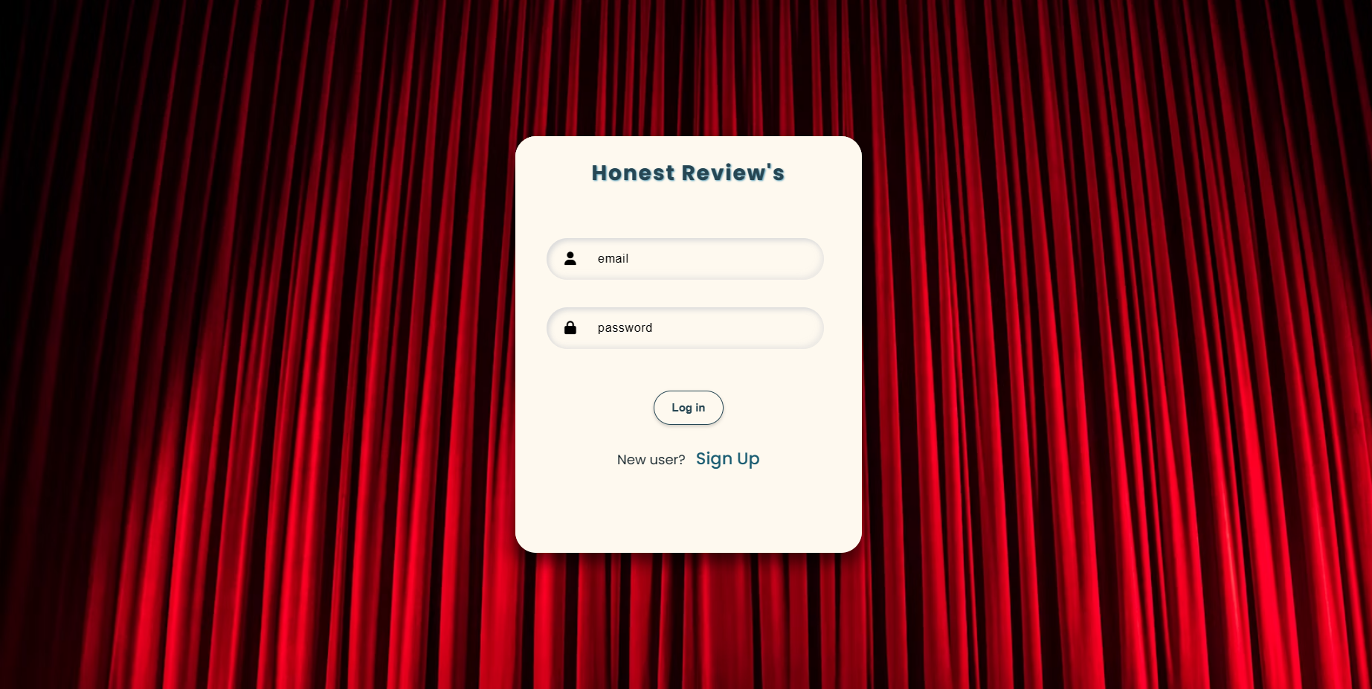
Login Page
The login page of Honest Movie Reviews serves as the entry point for registered users to access the platform. Key components include input fields for email and password, allowing users to securely log in to their accounts. The page also includes a submit button, enabling users to proceed with the authentication process efficiently. Additionally, there's a visually engaging element that allows users to switch between the login and signup pages seamlessly, enhancing the overall user experience.

Slide 5
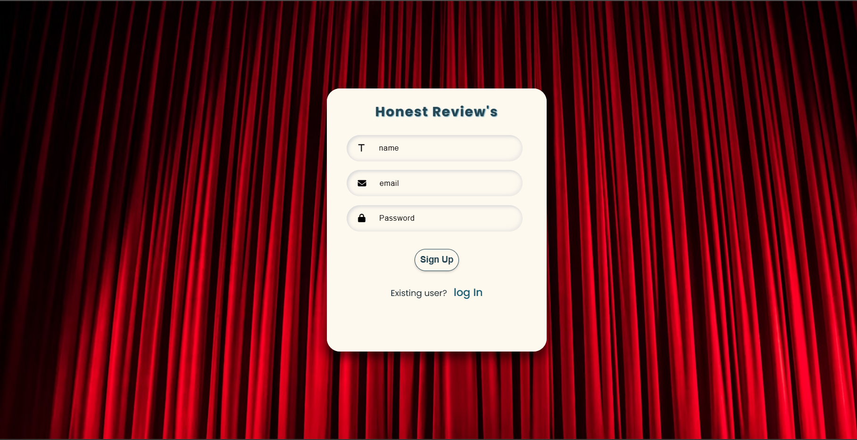
Sign up
The signup page of Honest Movie Reviews is tailored for new users who wish to create an account on the platform. It offers a straightforward registration process with input fields for name, email, and password. Users can input their details and submit the form to create their account. Similar to the login page, the signup page features a visually appealing element that facilitates navigation between the login and signup forms, ensuring a smooth transition for users. Overall, the signup page provides a user-friendly experience for newcomers to join the Honest Reviews community.

Slide 6
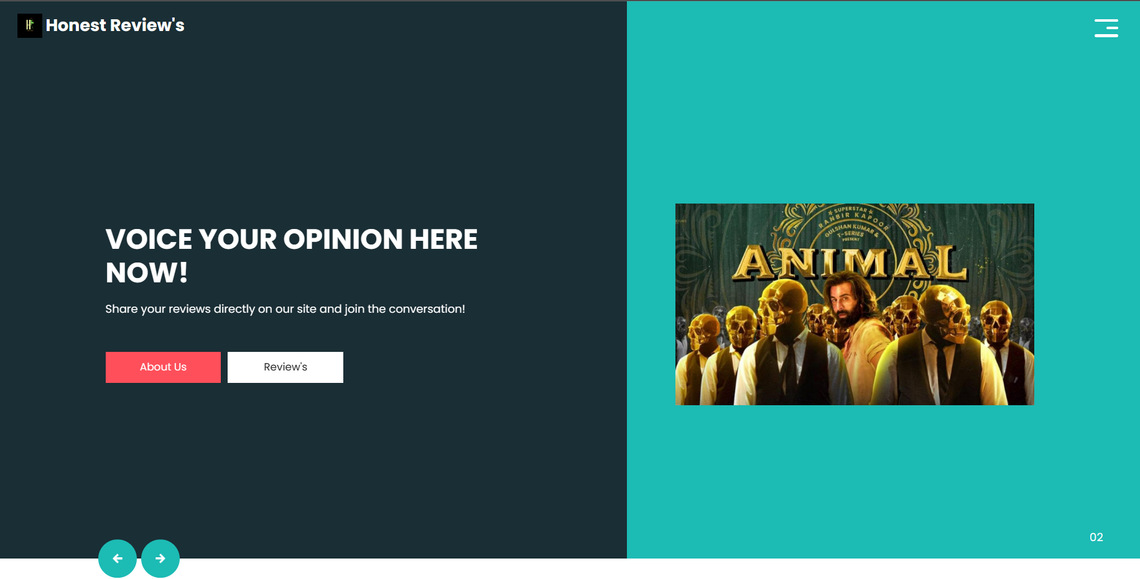
Home Page
The home page of Honest Movie Reviews welcomes visitors with a clean layout and clear navigation options. It prominently displays the platform's name and logo, ensuring easy recognition. Users can easily explore different sections of the website using the navigation menu, which includes links to essential pages such as Home, About Us, and Reviews. Engaging visuals and concise messages in the slider section grab users' attention, encouraging further exploration. The page also provides brief information about the platform's expertise in movie reviews and how users can get involved. Overall, the home page serves as an inviting gateway to the Honest Reviews platform, offering a user-friendly experience for visitors.

Slide 7
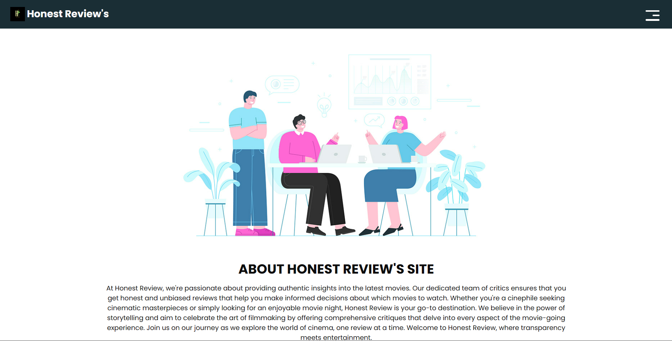
About Us
The "About Us" page of Honest Movie Reviews offers a concise overview of the platform's mission and values. It features the platform's logo and navigation links to key pages such as Home and Reviews. The main section provides a brief description of Honest Reviews' commitment to delivering authentic and unbiased movie reviews. Overall, the page serves as a succinct introduction to the platform's ethos and purpose.

Slide 8
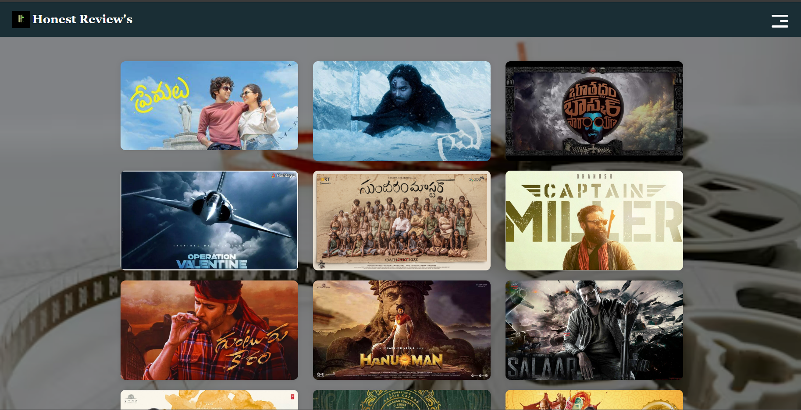
Review Page
The review page of Honest Movie Reviews offers a captivating array of movie images, each serving as a clickable link to a detailed review. Set against a backdrop of sleek design and enticing visuals, the page invites visitors to explore various movie critiques effortlessly. The navigation bar at the top ensures easy access to other essential sections of the website, such as the Home and About Us pages. With its user-friendly layout and engaging content, the review page provides a seamless browsing experience for movie enthusiasts seeking insightful and honest critiques.

Slide 9
Movie Review
Introduction: The webpage is a movie review platform dedicated to the film "Hi Nanna." It offers visitors an opportunity to explore reviews from both critics and ordinary users. The platform aims to provide a comprehensive overview of the movie, allowing users to read opinions from various perspectives and contribute their own reviews.
Navigation: At the top of the page, there is a navigation bar featuring links to different sections of the website, including Home, About Us, and Reviews. The logo of the website, along with a collapsible menu button, enhances user experience by facilitating easy access to different parts of the site.
Movie Information: The webpage provides essential details about the movie "Hi Nanna," such as its release date, cast, director, and a brief synopsis. Accompanied by an image of the movie poster, this section serves as an introduction to the film for visitors who may not be familiar with it.
Plot Summary: A succinct summary of the movie's plot is presented, highlighting key elements of the storyline and introducing main characters. This summary aims to give visitors a basic understanding of what to expect from the film without revealing too much detail.
Critic Reviews: Critics' reviews are showcased in this section, offering diverse perspectives on the movie. Each review is accompanied by a brief description and a notable quote, providing viewers with insights into the critical reception of "Hi Nanna" from various sources.

Slide 10
Movie Review
Recent User Reviews: Visitors can explore recent reviews submitted by other users, which include the user's name, rating, and review text. This section emphasizes the interactive nature of the website, where users can share their opinions and engage with fellow movie enthusiasts.
Submit Your Review: An interactive form allows users to submit their own reviews of the movie. Required fields include the user's name, email, rating, and review text. This feature encourages user engagement and participation, enhancing the overall community aspect of the website.
Footer: The bottom of the page contains a footer section with copyright information and links to the website's social media profiles. Additionally, contact information is provided, allowing users to reach out with any inquiries or feedback they may have.
Conclusion: In conclusion, the webpage serves as a comprehensive movie review platform for "Hi Nanna," catering to both critics and users alike. By offering diverse perspectives and encouraging user engagement, the website aims to provide a valuable resource for movie enthusiasts to explore and share their opinions on the film.

Slide 11
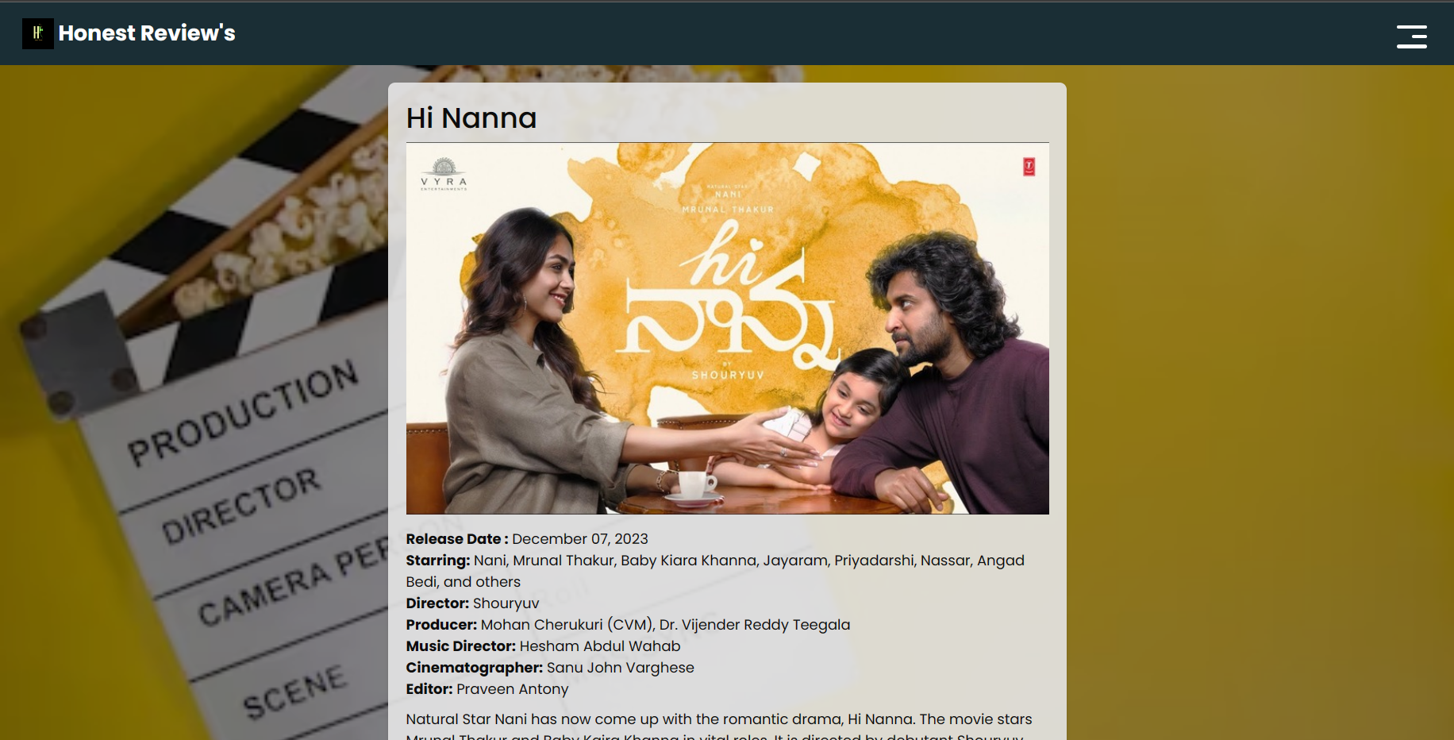
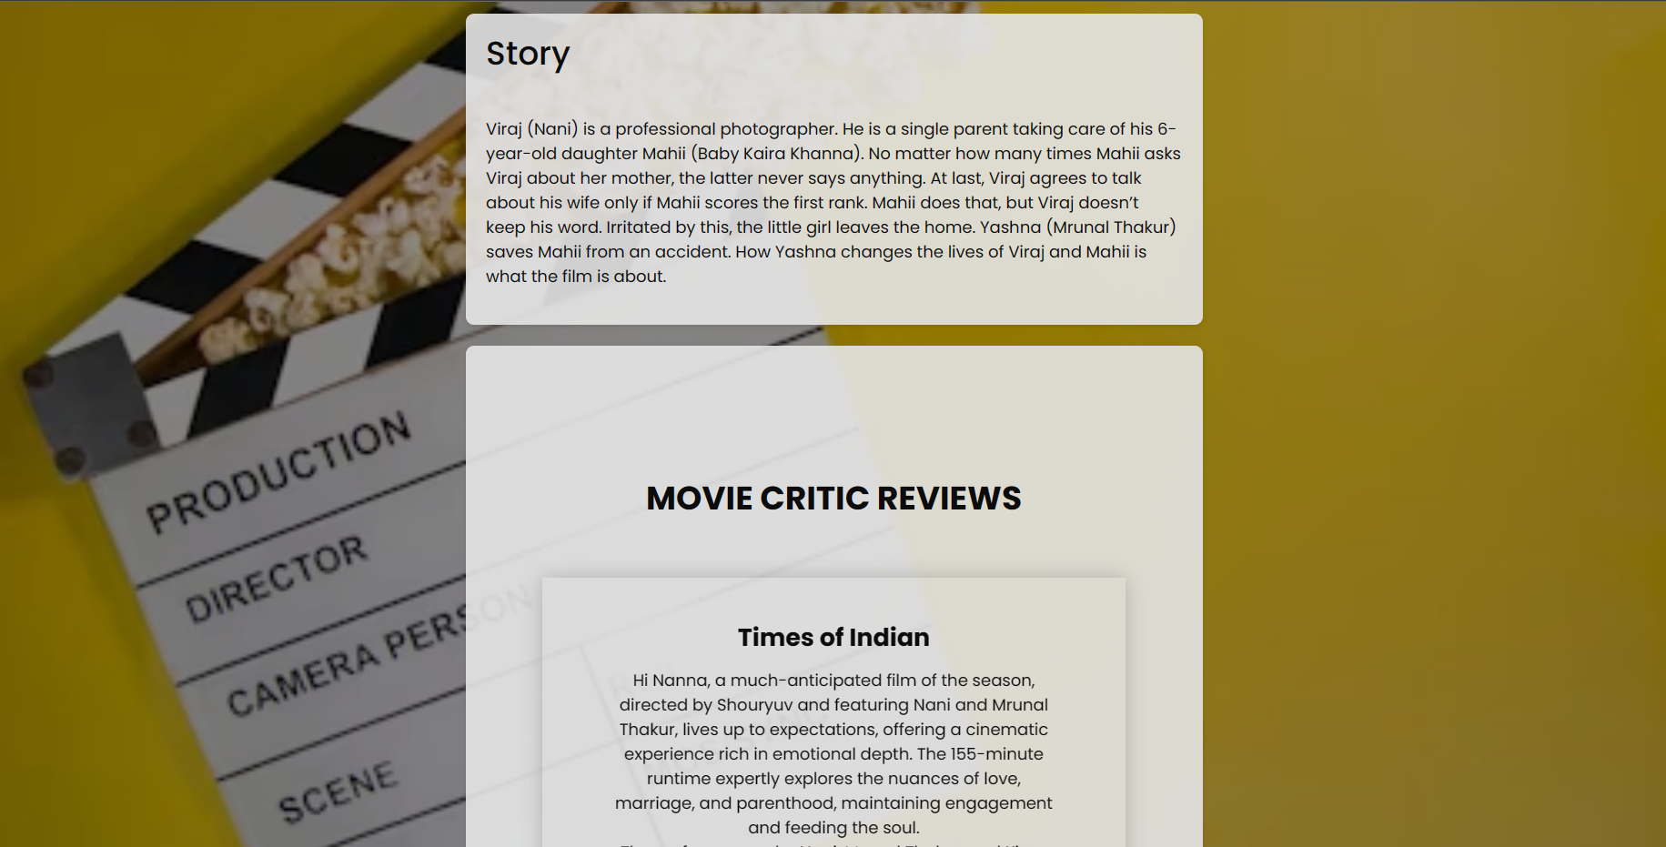
Movie Review

Slide 12
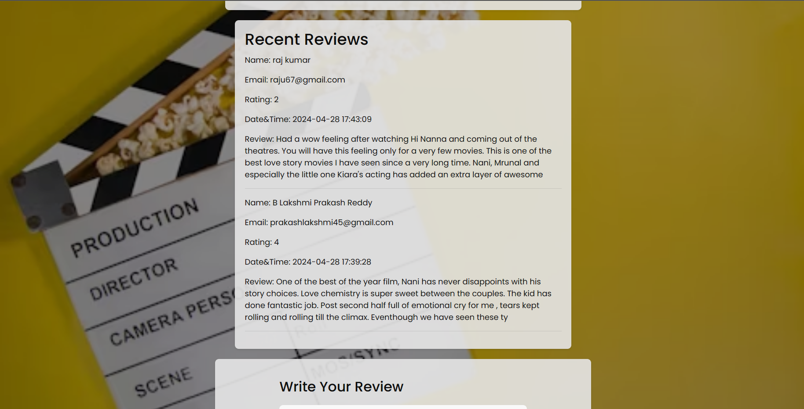
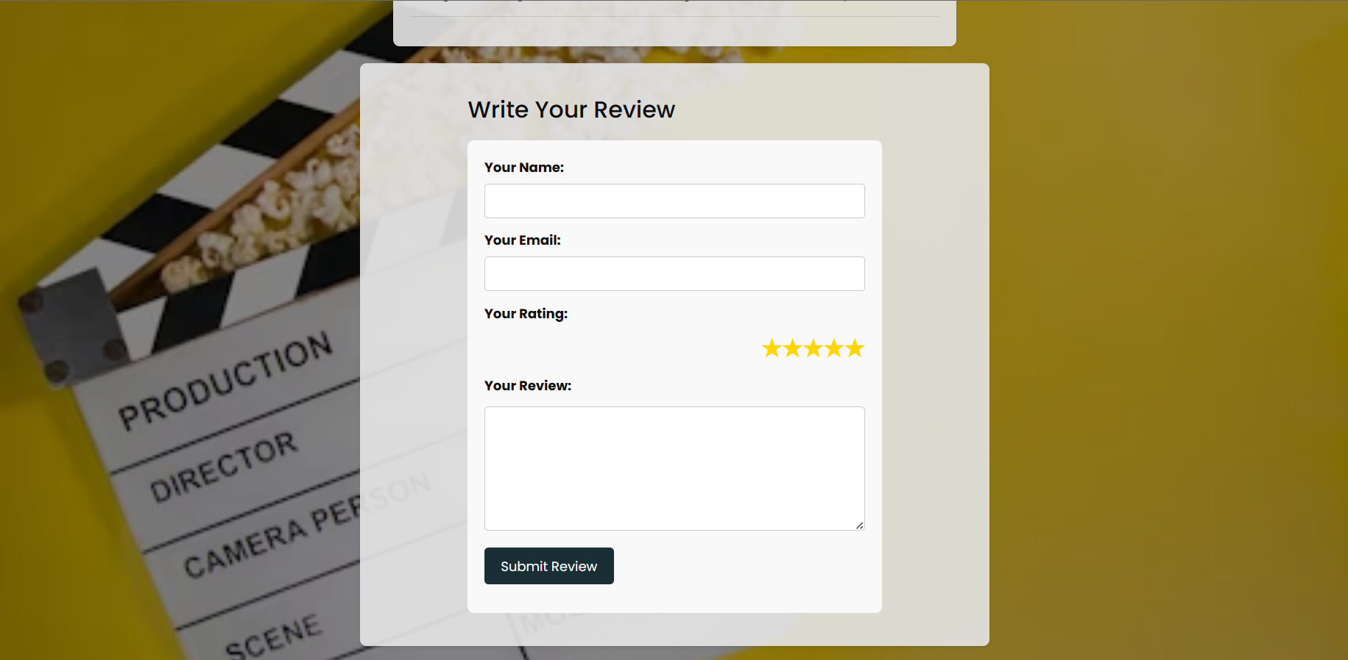
Movie Review

Slide 13
—Wes Anderson (American Filmmaker)
“I’ve never had a movie that got great reviews. I’ve had movies that got different levels of good and bad reviews, but you can more or less count on plenty of bad reviews.”

Slide 14
THANK YOU

